Slide 1
Breakout Session

Slide 2
Objectives Of Breakout Session
Design a pre-operative platform trial testing novel agents in patients with resectable NSCLC
Classify: Therapeutic versus non-therapeutic
Identify primary and secondary outcome measures

Slide 3
1. Which phase design would you select?
Window of opportunity
Phase 0
Phase 1
Phase 2
Phase 3
Objective: Design a pre-operative platform trial testing novel agents in patients with resectable NSCLC

Slide 4
Disclaimer*: over-simplified, relative to this scenario specifically
 | WOO | Phase 0 | Phase 1 | Phase 2 | Phase 3
N | Small | Small | Small | Medium | Large
Prior therapy | No | Yes | Yes | No | No
Safety Shown | Yes | No | No | Yes | Yes
Stage | Resectable | Advanced | Advanced | Resectable | Resectable
Dose | Therapeutic | Low | Escalating | Therapeutic | Therapeutic
Duration | Short | Short | Therapeutic | Therapeutic | Therapeutic
Objective | Exploratory | Safety | Safety | Efficacy | Efficacy
*I’m a pathologist….

Slide 5
First-in-human and safety studies generally are NOT done in untreated, early stage patients
 | WOO | Phase 0 | Phase 1 | Phase 2 | Phase 3
N | Small | Small | Small | Medium | Large
Prior therapy | No | Yes | Yes | No | No
Safety Shown | Yes | No | No | Yes | Yes
Stage | Resectable | Advanced | Advanced | Resectable | Resectable
Dose | Therapeutic | Low | Escalating | Therapeutic | Therapeutic
Duration | Short | Short | Therapeutic | Therapeutic | Therapeutic
Objective | Exploratory | Safety | Safety | Efficacy | Efficacy

Slide 6
1. Which phase design would you select?
Window of opportunity
Phase 0
Phase 1
Phase 2
Phase 3
Objective: Design a pre-operative platform trial testing novel agents in patients with resectable NSCLC

Slide 7
Testing for efficacy signals
 | WOO | Phase 0 | Phase 1 | Phase 2 | Phase 3
N | Small | Small | Small | Medium | Large
Prior therapy | No | Yes | Yes | No | No
Safety Shown | Yes | No | No | Yes | Yes
Common Stage | Resectable | Advanced | Advanced | Resectable | Resectable
Dose | Therapeutic | Low | Escalating | Therapeutic | Therapeutic
Duration | Short | Short | Therapeutic | Therapeutic | Therapeutic
Objective | Exploratory | Safety | Safety | Efficacy | Efficacy

Slide 8
1. Which phase design would you select?
Window of opportunity
Phase 0
Phase 1
Phase 2
Phase 3
Objective: Design a pre-operative platform trial testing novel agents in patients with resectable NSCLC

Slide 9
2. Which of the following are benefits of a platform trial design?
Assumes a heterogeneous patient population
Allows parallel and sequential testing of novel therapies and combinations
Trial adapts based on data collected
Pre-defined criteria for “success” or “failure” of a treatment arm
Speed and cost-efficiency
Objective: Design a pre-operative platform trial testing novel agents in patients with resectable NSCLC

Slide 10
2. Which of the following are benefits of a platform trial design?
Assumes a heterogeneous patient population
Allows parallel and sequential testing of novel therapies and combinations
Trial adapts based on data collected
Pre-defined criteria for “success” or “failure” of a treatment arm
Speed and cost-efficiency
All of the above

Slide 11
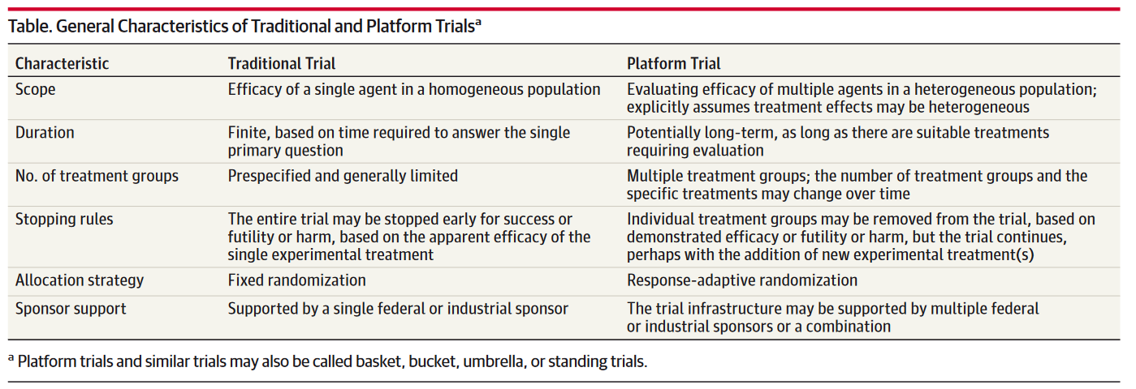
“A platform trial is defined by the broad goal of finding the best treatment for a disease by simultaneously investigating multiple treatments, using specialized statistical tools for allocating patients and analyzing results. The focus is on the disease rather than any particular experimental therapy.”
Berry et al. JAMA 2015

Slide 12
3. What are potential pro’s and con’s of using a biomarker-selected population?
Objective: Design a pre-operative platform trial testing novel agents in patients with resectable NSCLC

Slide 13
3. What are potential pro’s and con’s of using a biomarker-selected population?
Pro’s
May enrich for responders (e.g., positive trial more likely)
Reduces risk in patients unlikely to response
Support cost-effective care
May inform combinatorial therapies/precision therapy
Con’s
Testing costs and complexity
(# screen/eligible patient)
Slower accrual
Testing-related delays in treatment
(test-results turnaround)
Poor sensitivity
(untreated responders)
Poor specificity
(treated non-responders)

Slide 14
4. Which safety considerations are unique to neoadjuvant trials?
Disease progression
Surgical complications
Drug interactions
Adverse Events
Delay of surgery or inoperability
Objective: Design a pre-operative platform trial testing novel agents in patients with resectable NSCLC

Slide 15
4. Which safety considerations are unique to neoadjuvant trials?
Potentially curable (resectable)
Incurable (unresectable)
Disease progression (Feasibility)
Surgical complications (Safety)
Drug interactions
Adverse Events
Delay of surgery or inoperability (Feasibility)
*Patients and surgeons need this data

Slide 16
5. If our goal is speedy results, which efficacy outcome measure(s) is/are preferred?
Event-free survival (EFS)
Recurrence-free survival (RFS)
Major pathologic response (MPR)
Overall survival (OS)
Pathologic complete response (pCR)
Objective: Design a pre-operative platform trial testing novel agents in patients with resectable NSCLC

Slide 17
5. If our goal is speedy results, which efficacy endpoint(s) is/are preferred?
Event-free survival (EFS)*
Recurrence-free survival (RFS)
Major pathologic response (MPR)
Overall survival (OS)
Pathologic complete response (pCR)
Objective: Design a pre-operative platform trial testing novel agents in patients with resectable NSCLC

Slide 18
6. Proposed primary and secondary endpoints?
Objective: Design a pre-operative platform trial testing novel agents in patients with resectable NSCLC

Slide 19
6. Proposed primary and secondary endpoints?
Primary
Secondary
Safety
Feasibility
*power calculations
pCR and MPR
EFS at 2 years
Surgical outcomes
Downstaging
Radiologic response
Biomarkers
Quality of life

Slide 20
6. Proposed primary and secondary endpoints?
Safety
For grade 3 or higher adverse events
≥ 30% → discontinue arm
≤10% → continue
If ≤ 3 grade 3 or higher adverse events are observed in 20 patients: treatment is safe. Type I error = 0.11; power = 0.87 with exact binomial test
Feasibility
Treatment is considered feasible if 85% of patients receive surgery within 4 weeks of completion of 6 weeks of neoadjuvant therapy

Slide 21
Objectives
√ To identify role(s) of preoperative trials in cancer drug development
√ Identify key trial elements that guide the design of preoperative trials
√ Design a preoperative platform trial testing novel agents in patients with resectable NSCLC

Slide 22
THANK YOU

